Slide 1



How translators can improve
multilingual terminology in a link:
teaching case study examples
Carmen Gómez-Camarero y Rocío Palomares-Perraut
gomez@uma.es and perraut@uma.es
University of Malaga (Spain)

Slide 2
Can a translator control the ambiguity
of words when searching for information?

Slide 3

Search for information is becoming easier!
some reasons…
Altruism when sharing information (Web 2.0 movement)
Strong development of Social Networks on the Web
Open Access movement closed to scientific research outputs
Evolution of web technologies: AJAX, XML, CSS, Microformats….and
Semantic web or Web 3.0

Slide 4
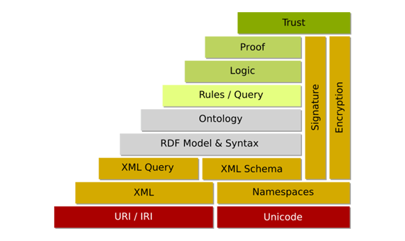
Semantic Web
"The Semantic Web is not a separate Web but an extension of the current one, in which information is given well-defined meaning, better enabling computers and people to work in cooperation."
Tim Berners-Lee, James Hendler and Ora Lassila; Scientific American, May 2001
The Internet of Things (Atzori et al., 2010)
“the Semantic Web Layer Cake"

Slide 5
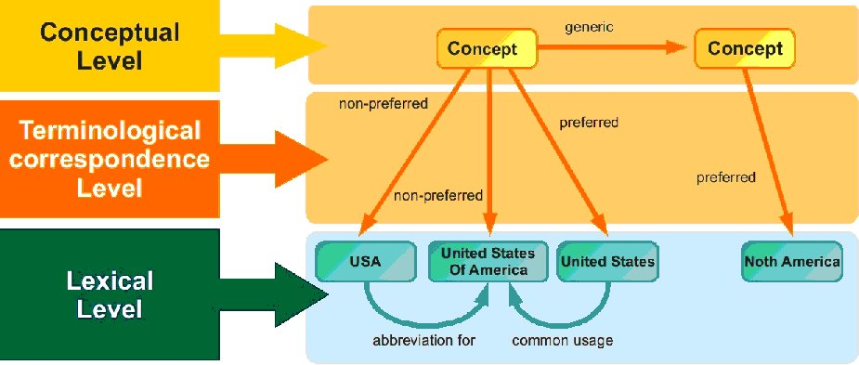
Semantic Web and controlled vocabularies
Thesauri
Classification schemes
Subject Headings Systems
Taxonomies
Why not for enriching and improving the translators’ multilingual terminology??
Storing and
retrieving information
Organizational levels of a concept-based thesaurus (Pastor-Sánchez, J.A. 2009)
Organizational levels of a concept-based thesaurus (Pastor-Sánchez, J.A. 2009)
Organizational levels of a concept-based thesaurus (Pastor-Sánchez, J.A. 2009)
Organizational levels of a concept-based thesaurus (Pastor-Sánchez, J.A. 2009)
Organizational levels of a concept-based thesaurus (Pastor-Sánchez, J.A. 2009)
Organizational levels of a concept-based thesaurus (Pastor-Sánchez, J.A. 2009)
Organizational levels of a concept-based thesaurus (Pastor-Sánchez, J.A. 2009)

Slide 6
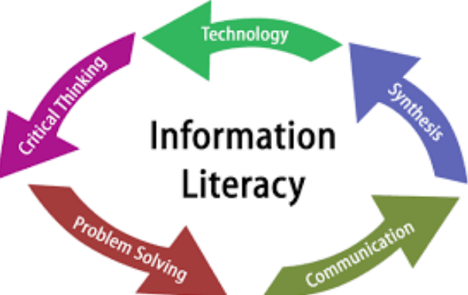
Teaching aims
1. To enrich and improve translators’ and interpreters’ multilingual terminology
2. To train the students’ skills in using controlled vocabularies that apply Semantic Web technologies (LOD, SKOS, URIs…)
3. Enhance their critical thinking skill when searching for information.
Organizational levels of a concept-based thesaurus (Pastor-Sánchez, J.A. 2009)
Organizational levels of a concept-based thesaurus (Pastor-Sánchez, J.A. 2009)
Organizational levels of a concept-based thesaurus (Pastor-Sánchez, J.A. 2009)
Organizational levels of a concept-based thesaurus (Pastor-Sánchez, J.A. 2009)
Organizational levels of a concept-based thesaurus (Pastor-Sánchez, J.A. 2009)
Organizational levels of a concept-based thesaurus (Pastor-Sánchez, J.A. 2009)
Organizational levels of a concept-based thesaurus (Pastor-Sánchez, J.A. 2009)

Slide 7
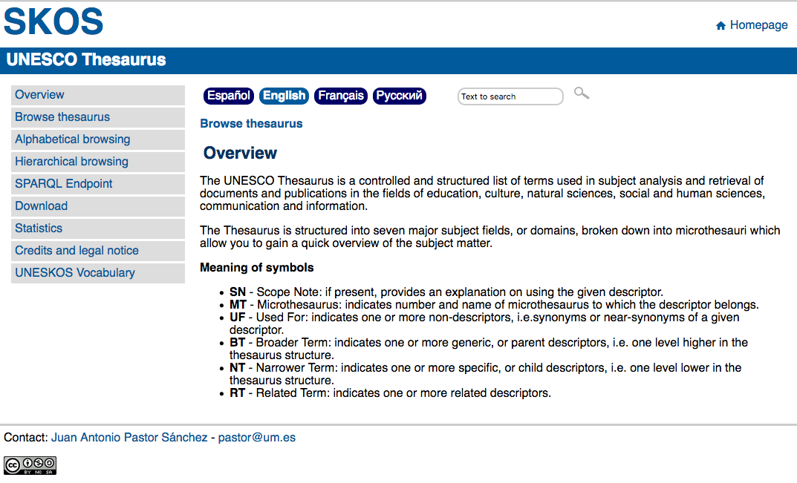
Description of the teaching method: an example
The terminological multilingual tool
Organizational levels of a concept-based thesaurus (Pastor-Sánchez, J.A. 2009)
Organizational levels of a concept-based thesaurus (Pastor-Sánchez, J.A. 2009)
Organizational levels of a concept-based thesaurus (Pastor-Sánchez, J.A. 2009)
Organizational levels of a concept-based thesaurus (Pastor-Sánchez, J.A. 2009)
Organizational levels of a concept-based thesaurus (Pastor-Sánchez, J.A. 2009)
Organizational levels of a concept-based thesaurus (Pastor-Sánchez, J.A. 2009)
Organizational levels of a concept-based thesaurus (Pastor-Sánchez, J.A. 2009)

Slide 8
Thesaurus: Controlled Vocabulary
Relationships herarchy, association and equivalence
Organizational levels of a concept-based thesaurus (Pastor-Sánchez, J.A. 2009)
Organizational levels of a concept-based thesaurus (Pastor-Sánchez, J.A. 2009)
Organizational levels of a concept-based thesaurus (Pastor-Sánchez, J.A. 2009)
Organizational levels of a concept-based thesaurus (Pastor-Sánchez, J.A. 2009)
Organizational levels of a concept-based thesaurus (Pastor-Sánchez, J.A. 2009)
Organizational levels of a concept-based thesaurus (Pastor-Sánchez, J.A. 2009)
Organizational levels of a concept-based thesaurus (Pastor-Sánchez, J.A. 2009)

Slide 9
Description of the teaching method: an example
It is a Semantic Web Technology which uses Linked Open Data
It is a multilingual tool
Organizational levels of a concept-based thesaurus (Pastor-Sánchez, J.A. 2009)
Organizational levels of a concept-based thesaurus (Pastor-Sánchez, J.A. 2009)
Organizational levels of a concept-based thesaurus (Pastor-Sánchez, J.A. 2009)
Organizational levels of a concept-based thesaurus (Pastor-Sánchez, J.A. 2009)
Organizational levels of a concept-based thesaurus (Pastor-Sánchez, J.A. 2009)
Organizational levels of a concept-based thesaurus (Pastor-Sánchez, J.A. 2009)
Organizational levels of a concept-based thesaurus (Pastor-Sánchez, J.A. 2009)

Slide 10
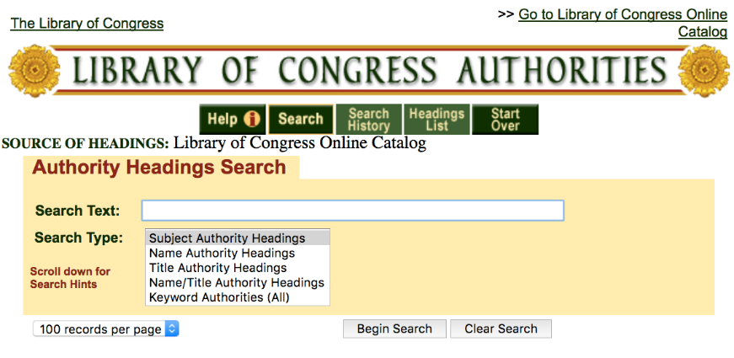
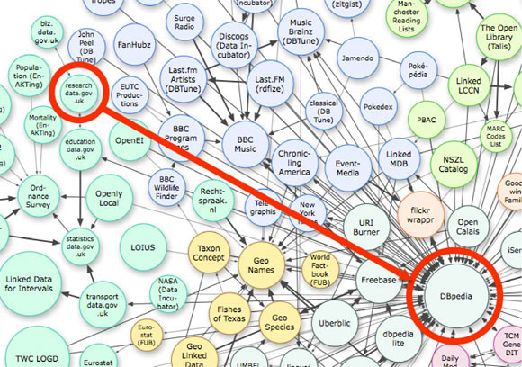
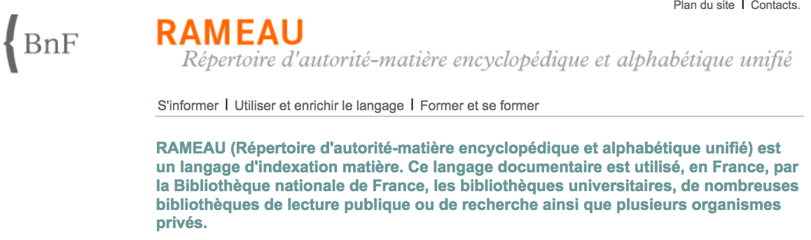
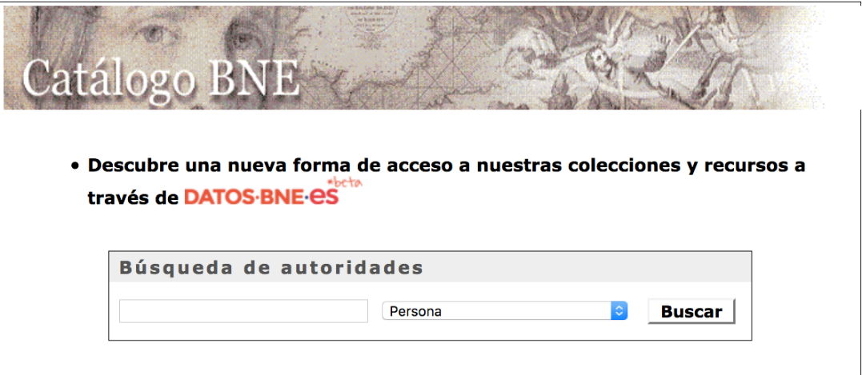
Library of Congress Subject Headings (EN)
Linked
Open
Data
National Library of Spain
Catálogo de Autoridades(ES)
National Library of France
RAMEAU(FR)
Organizational levels of a concept-based thesaurus (Pastor-Sánchez, J.A. 2009)
Organizational levels of a concept-based thesaurus (Pastor-Sánchez, J.A. 2009)
Organizational levels of a concept-based thesaurus (Pastor-Sánchez, J.A. 2009)
Organizational levels of a concept-based thesaurus (Pastor-Sánchez, J.A. 2009)
Organizational levels of a concept-based thesaurus (Pastor-Sánchez, J.A. 2009)
Organizational levels of a concept-based thesaurus (Pastor-Sánchez, J.A. 2009)
Organizational levels of a concept-based thesaurus (Pastor-Sánchez, J.A. 2009)

Slide 11
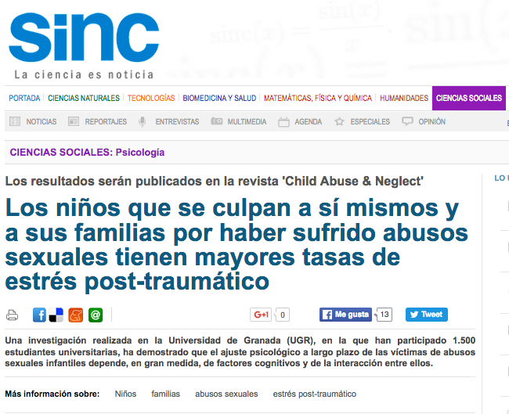
Description of the teaching method: an example
1. Offer a text -500 words- and select the three main keywords of the text
Subject of the text
Role of coping strategies and attributions of blame on the psychological adjustment of victims of child sexual abuse
Organizational levels of a concept-based thesaurus (Pastor-Sánchez, J.A. 2009)
Organizational levels of a concept-based thesaurus (Pastor-Sánchez, J.A. 2009)
Organizational levels of a concept-based thesaurus (Pastor-Sánchez, J.A. 2009)
Organizational levels of a concept-based thesaurus (Pastor-Sánchez, J.A. 2009)
Organizational levels of a concept-based thesaurus (Pastor-Sánchez, J.A. 2009)
Organizational levels of a concept-based thesaurus (Pastor-Sánchez, J.A. 2009)
Organizational levels of a concept-based thesaurus (Pastor-Sánchez, J.A. 2009)

Slide 12
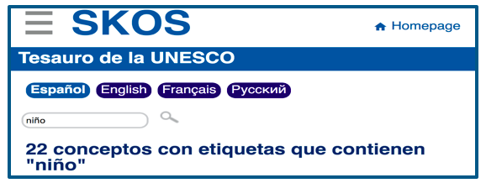
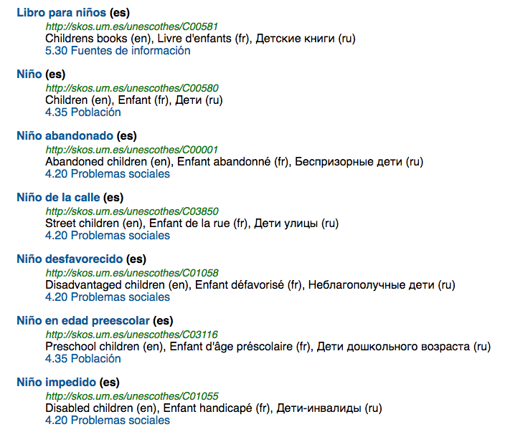
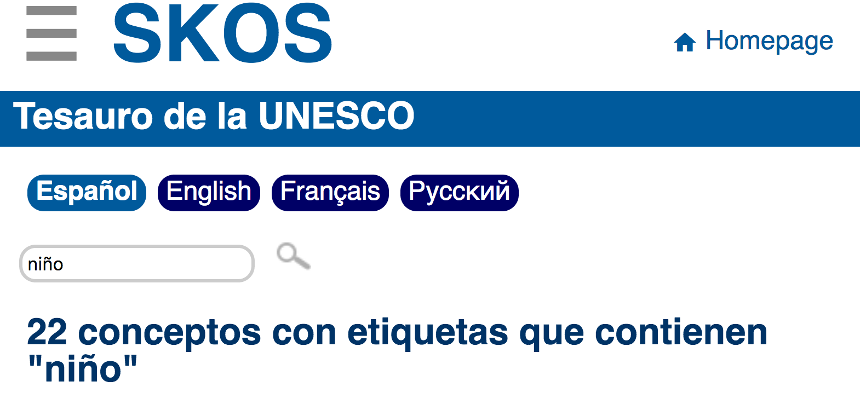
Description of the teaching method: an example
Step one: Search the term “Children”
Step two:
In the Context of
4.20 Social Sciences
1
Organizational levels of a concept-based thesaurus (Pastor-Sánchez, J.A. 2009)
Organizational levels of a concept-based thesaurus (Pastor-Sánchez, J.A. 2009)
Organizational levels of a concept-based thesaurus (Pastor-Sánchez, J.A. 2009)
Organizational levels of a concept-based thesaurus (Pastor-Sánchez, J.A. 2009)
Organizational levels of a concept-based thesaurus (Pastor-Sánchez, J.A. 2009)
Organizational levels of a concept-based thesaurus (Pastor-Sánchez, J.A. 2009)
Organizational levels of a concept-based thesaurus (Pastor-Sánchez, J.A. 2009)

Slide 13
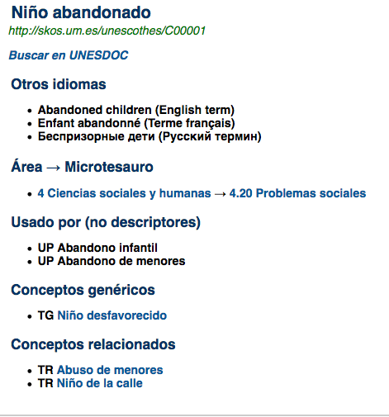
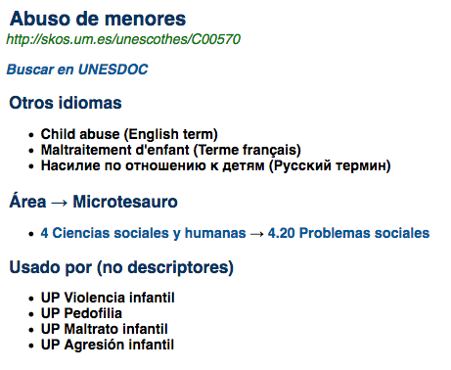
Description of the teaching method: an example
Step three: Arbitrarily, select “Niño abandonado”
Step four: Abuso de menores (TR)
Step five:
Find synonimous
Organizational levels of a concept-based thesaurus (Pastor-Sánchez, J.A. 2009)
Organizational levels of a concept-based thesaurus (Pastor-Sánchez, J.A. 2009)
Organizational levels of a concept-based thesaurus (Pastor-Sánchez, J.A. 2009)
Organizational levels of a concept-based thesaurus (Pastor-Sánchez, J.A. 2009)
Organizational levels of a concept-based thesaurus (Pastor-Sánchez, J.A. 2009)
Organizational levels of a concept-based thesaurus (Pastor-Sánchez, J.A. 2009)
Organizational levels of a concept-based thesaurus (Pastor-Sánchez, J.A. 2009)

Slide 14
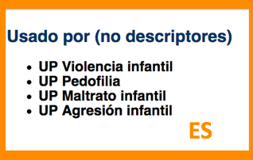
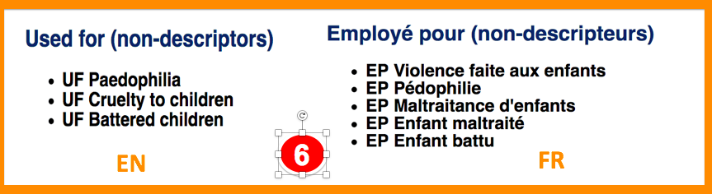
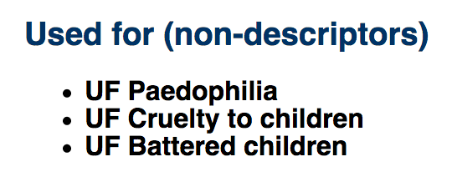
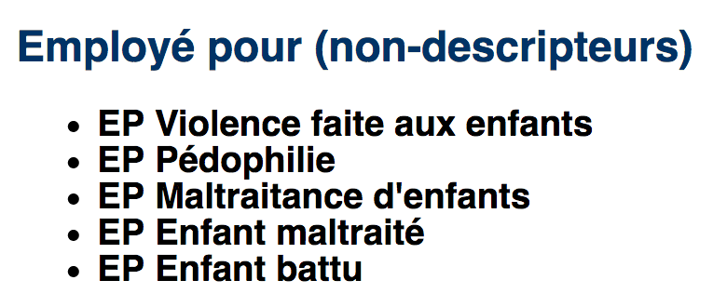
Description of the teaching method: an example
Step six: enrich translators’ multilingual terminology of those synonyms found
in a link!
Organizational levels of a concept-based thesaurus (Pastor-Sánchez, J.A. 2009)
Organizational levels of a concept-based thesaurus (Pastor-Sánchez, J.A. 2009)
Organizational levels of a concept-based thesaurus (Pastor-Sánchez, J.A. 2009)
Organizational levels of a concept-based thesaurus (Pastor-Sánchez, J.A. 2009)
Organizational levels of a concept-based thesaurus (Pastor-Sánchez, J.A. 2009)
Organizational levels of a concept-based thesaurus (Pastor-Sánchez, J.A. 2009)
Organizational levels of a concept-based thesaurus (Pastor-Sánchez, J.A. 2009)
6
EN
6
FR
EN
FR

Slide 15

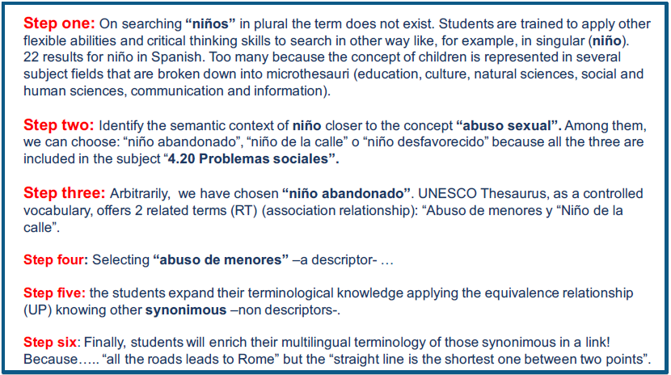
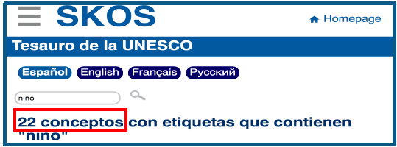
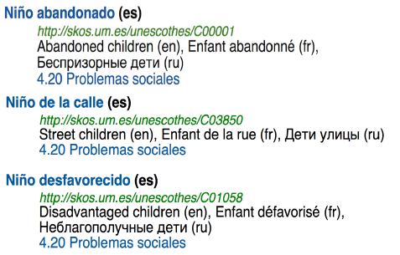

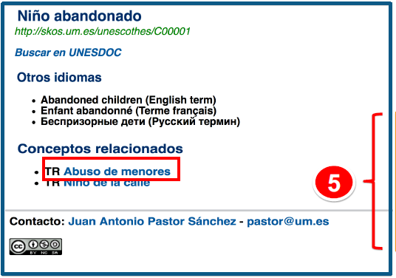


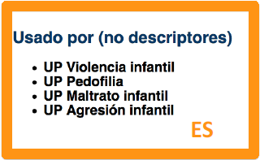
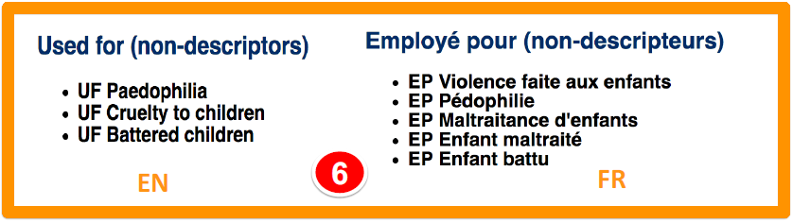
Description of the teaching method: an example

Slide 16
Conclusions
  Enriching and improving translators’ and interpreters’ multilingual terminology.
  Extracting and identifying the main ideas of the source text by keywords.
  Getting to know, understanding and managing controlled vocabularies.
  Being flexible, creative and resourceful searchers to find data and information.
  Enhancing their critical thinking skills when searching for information, and….

Slide 17
Conclusions
  Being capable to combine, reformulate, research, infer and experiment new ways of searching on the Web or any database because, as the saying goes...
  “all roads lead to Rome” but “a straight line is the shortest distance between two points”

Slide 18
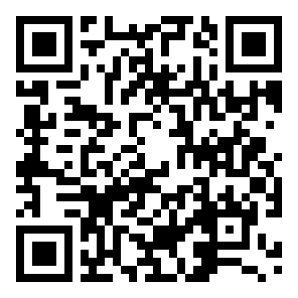
Selective Bibliography
Selective Bibliography
- Atzori et al. 2010. The Internet of Things: A survey, Computer Networks, 4: 2787–2805. DOI: 10.1016/j.comnet.2010.05.010c
- ACRL. 2016. Information Literacy Competency Standards for Higher Education. Chicago: American Library Association.
- Pastor-Sánchez, Juan-Antonio. 2011. Tecnologías de la web semántica. Barcelona: UOC.
- SKOS-Tesauro de la UNESCO. 2016. http://skos.um.es/unescothes/?l=es (September 2016).
Selective Bibliography
- Atzori et al. 2010. The Internet of Things: A survey, Computer Networks, 4: 2787–2805. DOI: 10.1016/j.comnet.2010.05.010c
- ACRL. 2016. Information Literacy Competency Standards for Higher Education. Chicago: American Library Association.
- Pastor-Sánchez, Juan-Antonio. 2011. Tecnologías de la web semántica. Barcelona: UOC.
- SKOS-Tesauro de la UNESCO. 2016. http://skos.um.es/unescothes/?l=es (September 2016).

Slide 19
QR Code
Selective Bibliography
- Atzori et al. 2010. The Internet of Things: A survey, Computer Networks, 4: 2787–2805. DOI: 10.1016/j.comnet.2010.05.010c
- ACRL. 2016. Information Literacy Competency Standards for Higher Education. Chicago: American Library Association.
- Pastor-Sánchez, Juan-Antonio. 2011. Tecnologías de la web semántica. Barcelona: UOC.
- SKOS-Tesauro de la UNESCO. 2016. http://skos.um.es/unescothes/?l=es (September 2016).

