Slide 1


Selling translation online.
A path to success.
Emanuele Caronia - Marketing Director - MateCat
Translating and the Computer 2016 - London

Slide 2
I will keep it quick

Slide 3
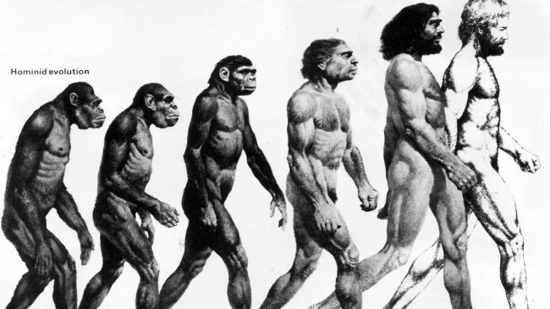
The history of humans

Slide 4
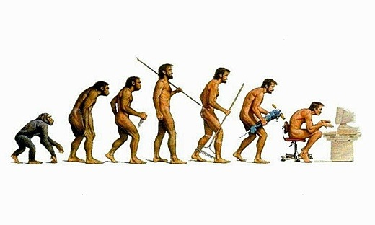

Slide 5
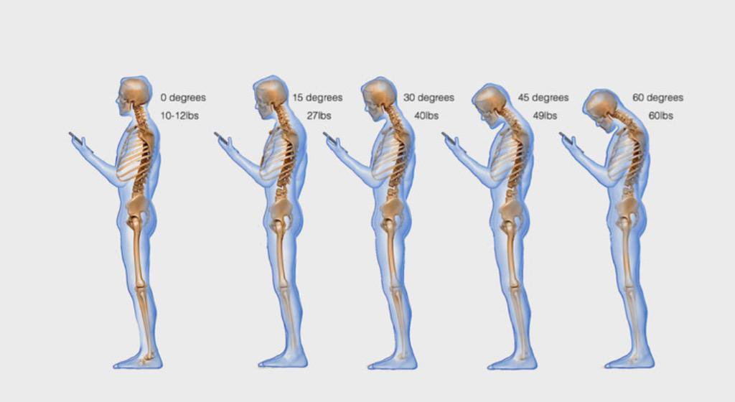
Phono sapiens

Slide 6
We live in the _______ era

Slide 7
Do we live in the technology era?

Slide 8
Do we live in the internet era?

Slide 9
Do we live in the smartphones era?

Slide 10
We live in the e-commerce era

Slide 11
We buy things online

Slide 12
A lot of things :-)

Slide 13
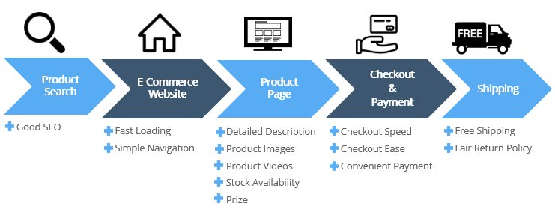
convenient, easy, comfortable, useful
What makes a good Online Experience?

Slide 14





We use internet and the smartphone for these activities

Slide 15

We use the internet (a lot) to buy things

Slide 16
To find the best product in a given category
The cheapest product
The cheapest reseller
To look for the best shop
To compare brands, prices, features
To know products better than the seller

Slide 17

The everything store

Slide 18
Right or wrong, this is the everyday experience of hundreds of millions of people around the world

Slide 19
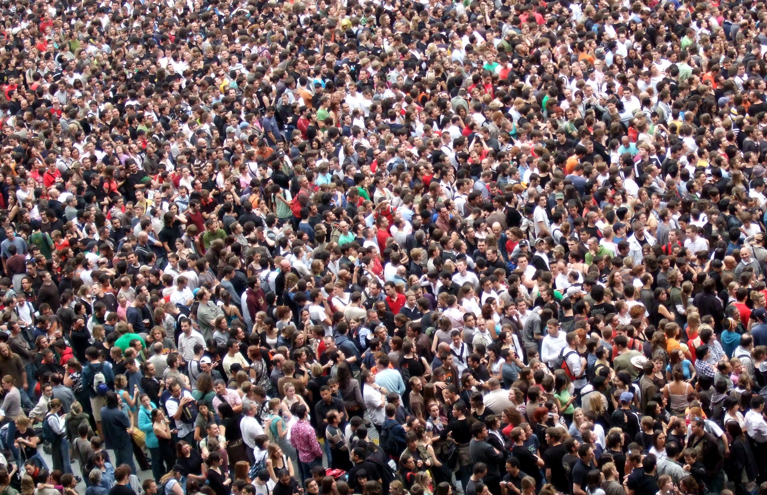

Slide 20
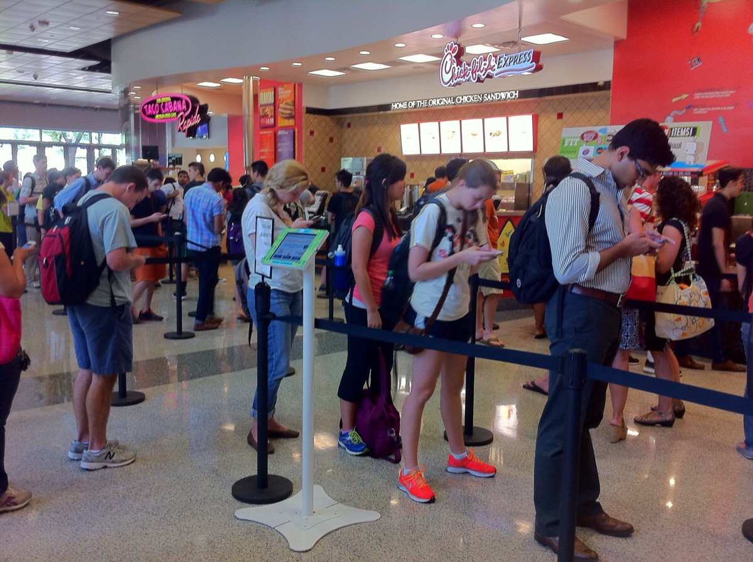

Slide 21
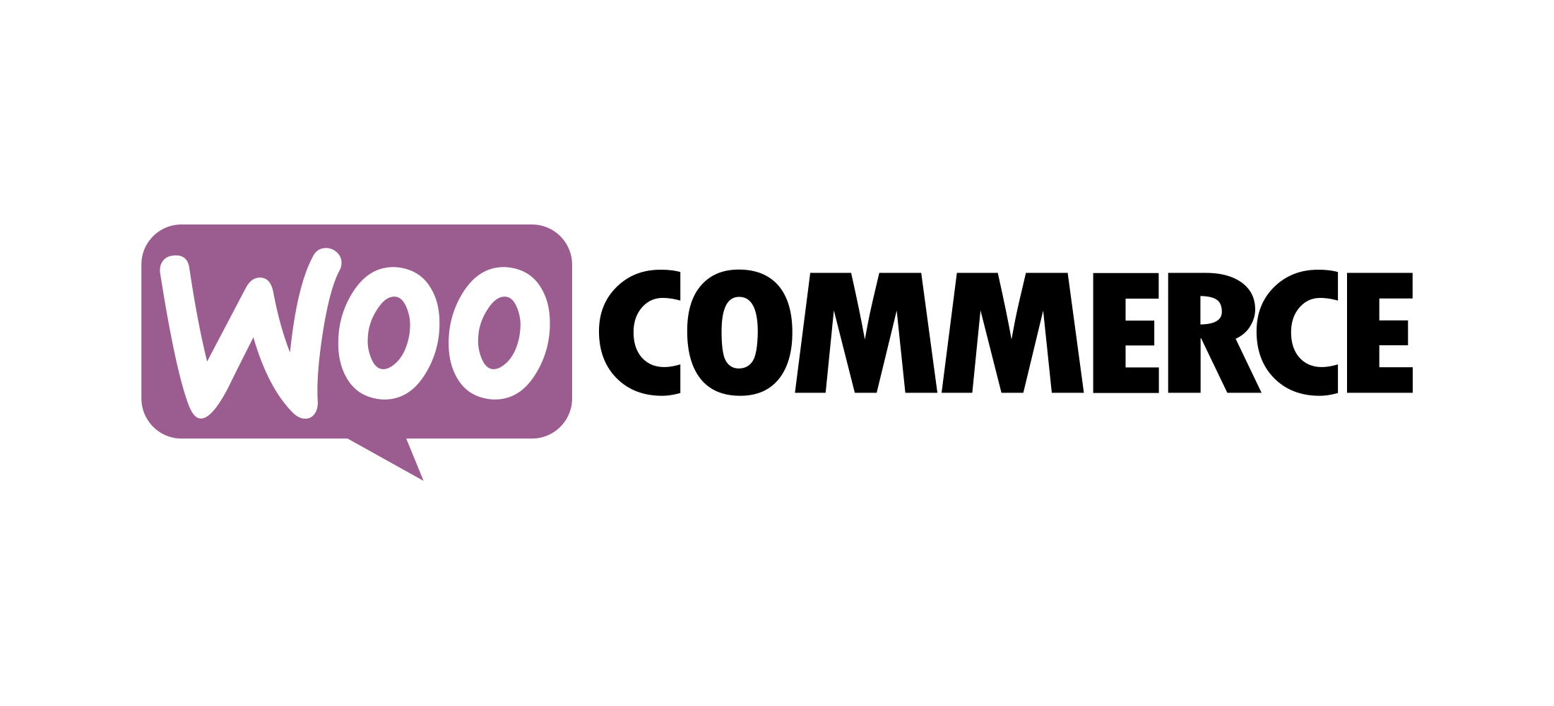





Slide 22
We can create shops in minutes

Slide 23
The question is:
is the translation industry ready for this?

Slide 24
Not really

Slide 25
Only 10% of the translation market is online

Slide 26
Why?

Slide 27
Probably you are thinking that the translation industry is different

Slide 28
you are thinking that is not possible to sell translation services online

Slide 29
because a translation is a different beast

Slide 30
it’s not a product

Slide 31
But I’m sure that many customers or website visitors would be very happy to buy translations from the agency website

Slide 32
or at least to have a quotation and a delivery date for a translation job

Slide 33
why I’m sure?

Slide 34
Because Translated.net sells more than 10M worth of translations online every year and is growing fast. Very fast.

Slide 35
Ok… There are many reasons for this:
Streamlined processes
Optimisation
Huge network of translators
T-rank technology
MyMemory (largest public memory in the world)
More than 15 years of experience selling translation services online

Slide 36
but this is not the case for the typical agency

Slide 37
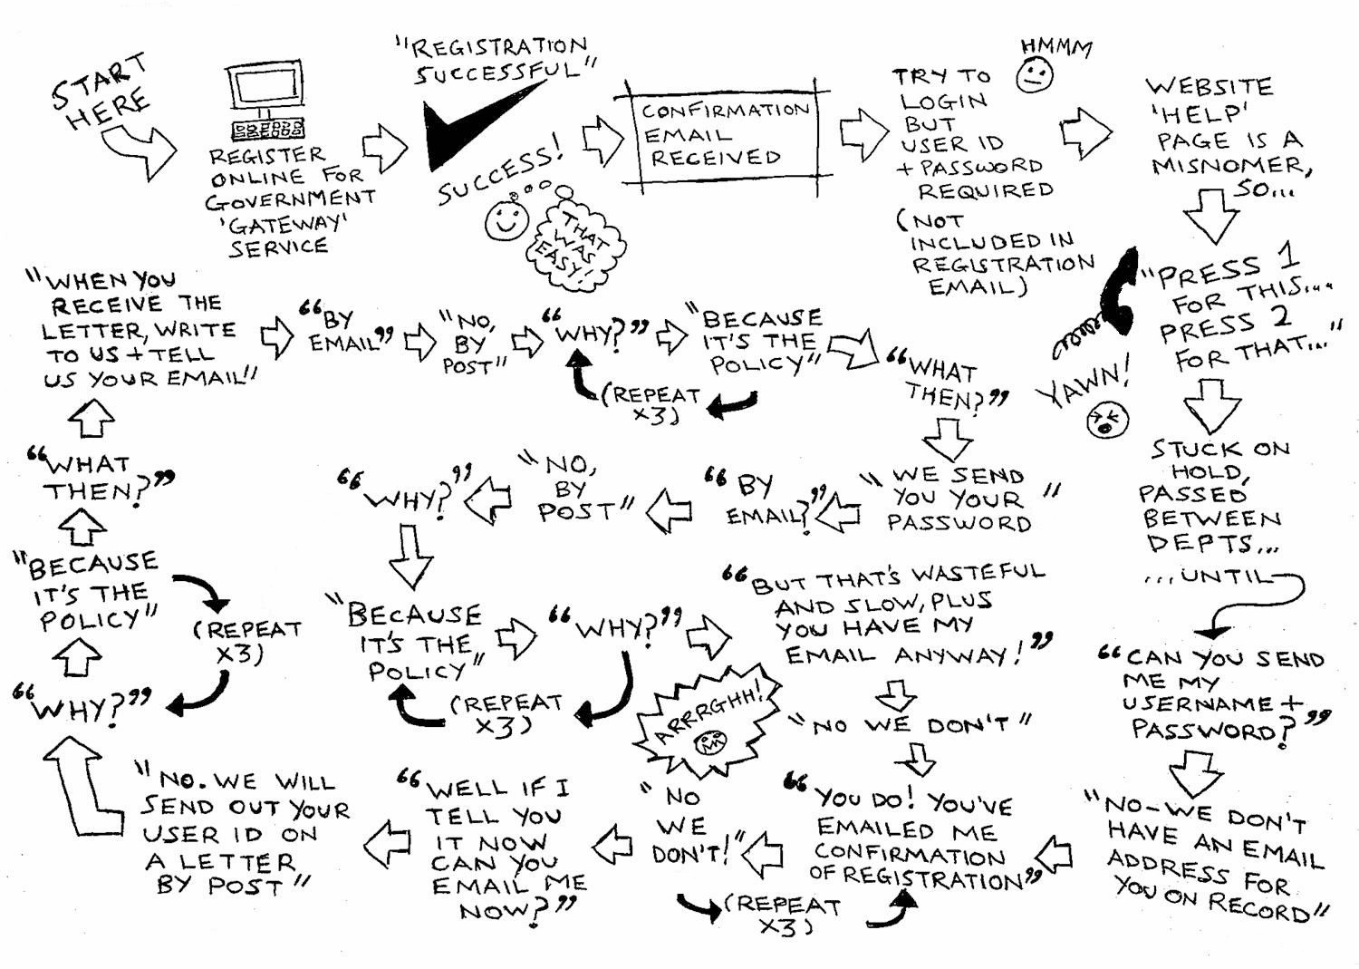
Buying translations

Slide 38
it took hours if not an entire day to give a quotation and a delivery date to the customer

Slide 39
In this hyper-connected world, when an agency is slow to react to a request
(meaning that it doesn’t deliver it in real time)
is going to lose a lot of customers and $$.

Slide 40
But here I’d like to focus on the most critical aspect

Slide 41
The interaction between prospects and the agency website

Slide 42
Translated.net put a lot of efforts to create the best experience for his customers

Slide 43
It gained a lot of experience and knowledge about this

Slide 44
And this is why Translated.net created MateCat Instant Quote Widget

Slide 45
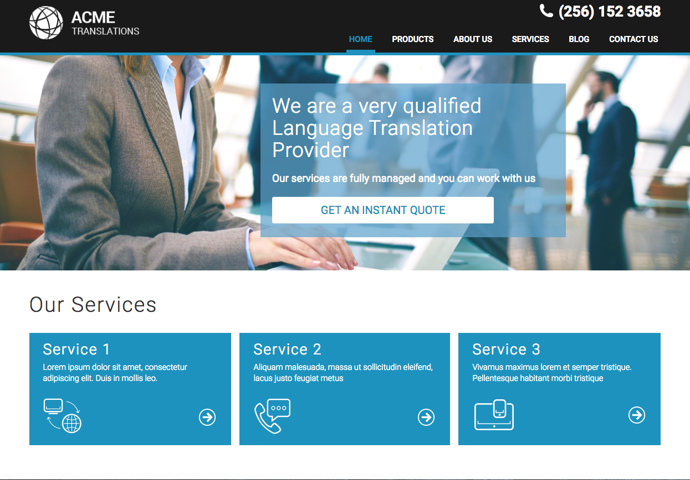

Slide 46
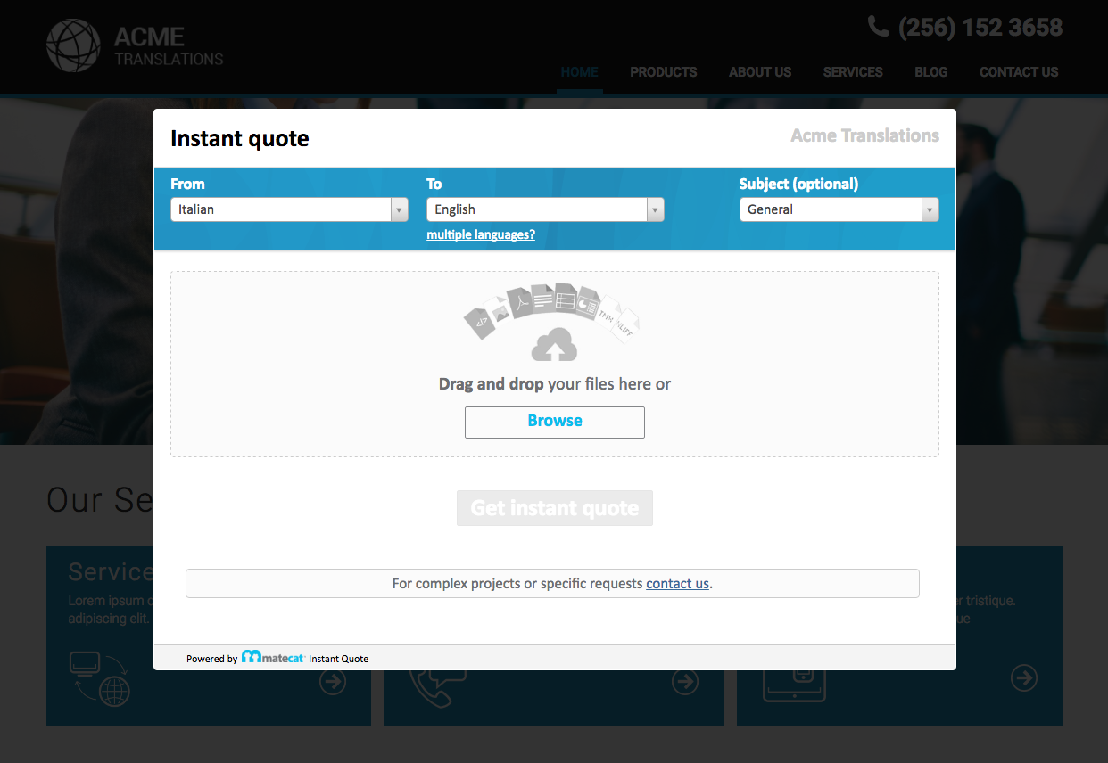

Slide 47
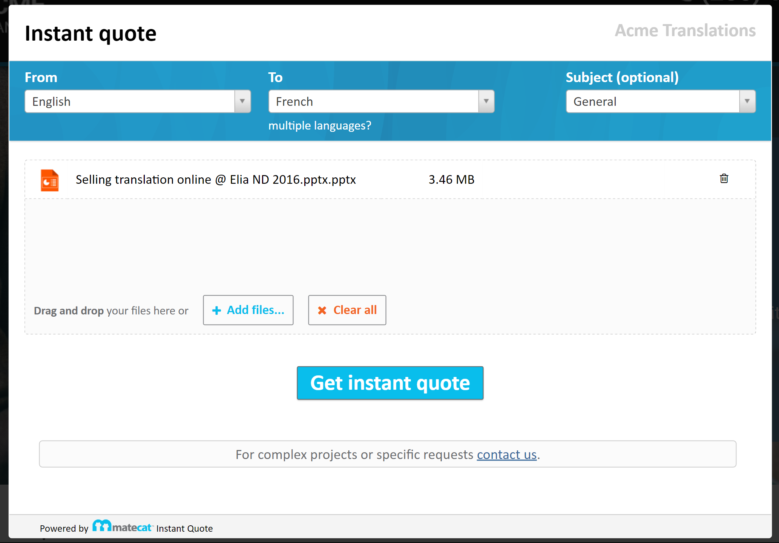

Slide 48
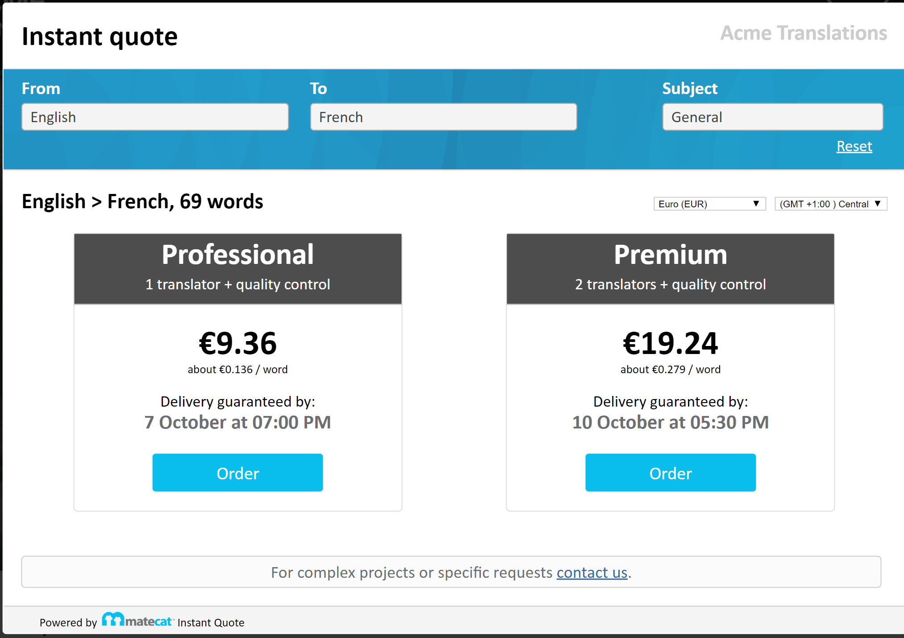

Slide 49
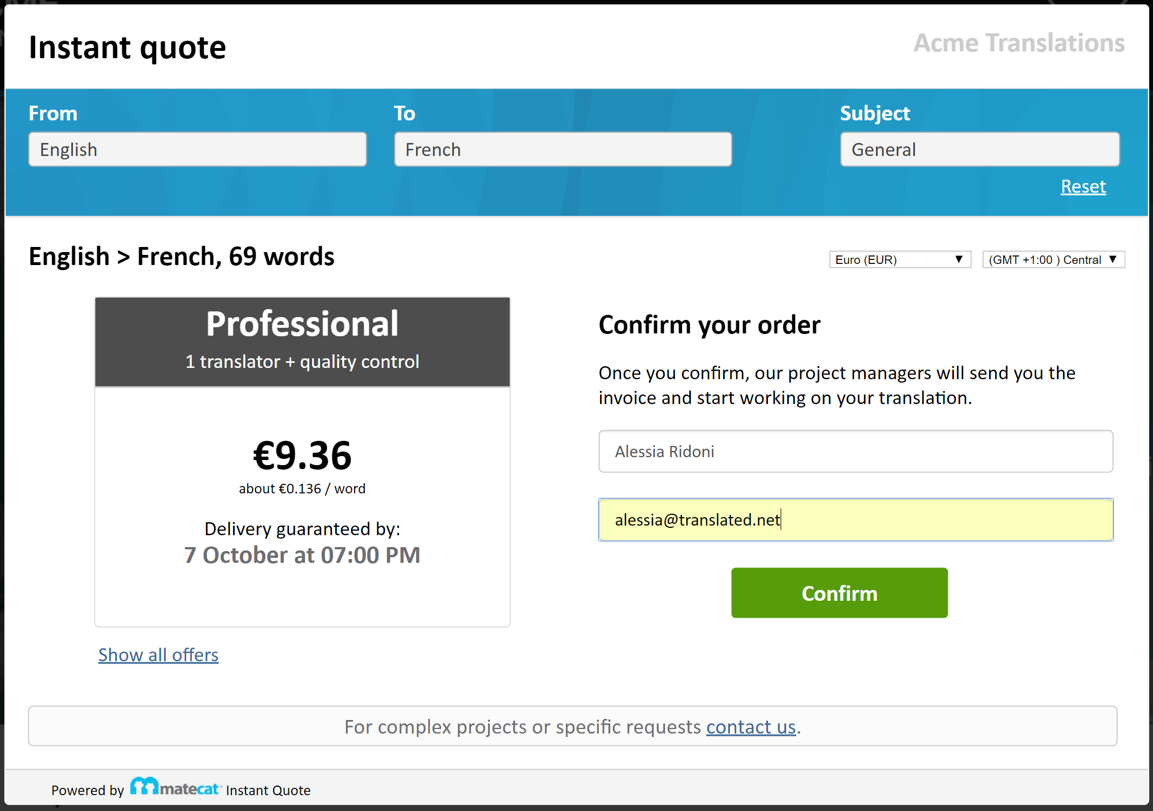

Slide 50
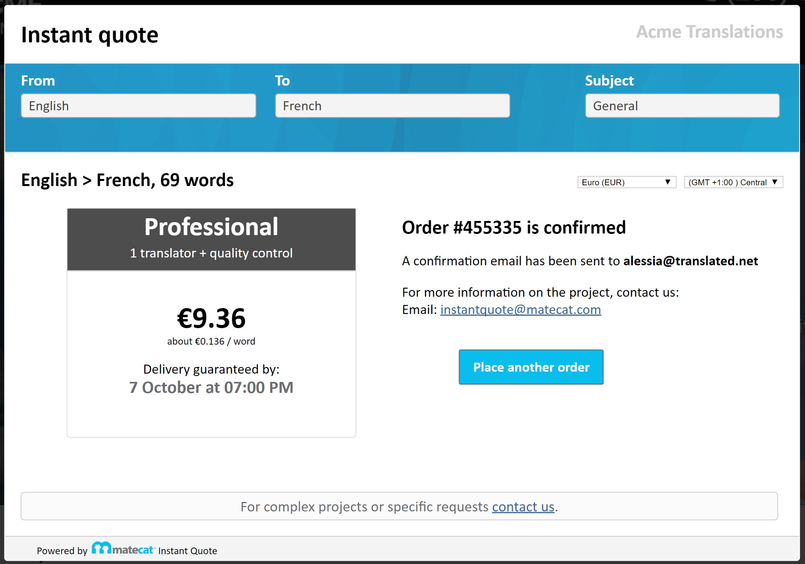

Slide 51
We believe that this is the future for the translation industry

Slide 52
Join the Evolution
http://instantquote.matecat.com/
instantquote@matecat.com

