Slide 1
Will curiosity kill the CAT?
Thoughts on the future of the computer assisted translation environment
Translating and the Computer 38, 16 November 2016 - London
Dieter Rummel, Head of the IT Unit
European Commission, DGT

Slide 2
Let's talk about CATs (literally)
Curiosity
Intermission: A short rant
CATE 2020 – an unspectacular vision
DOGs

Slide 3
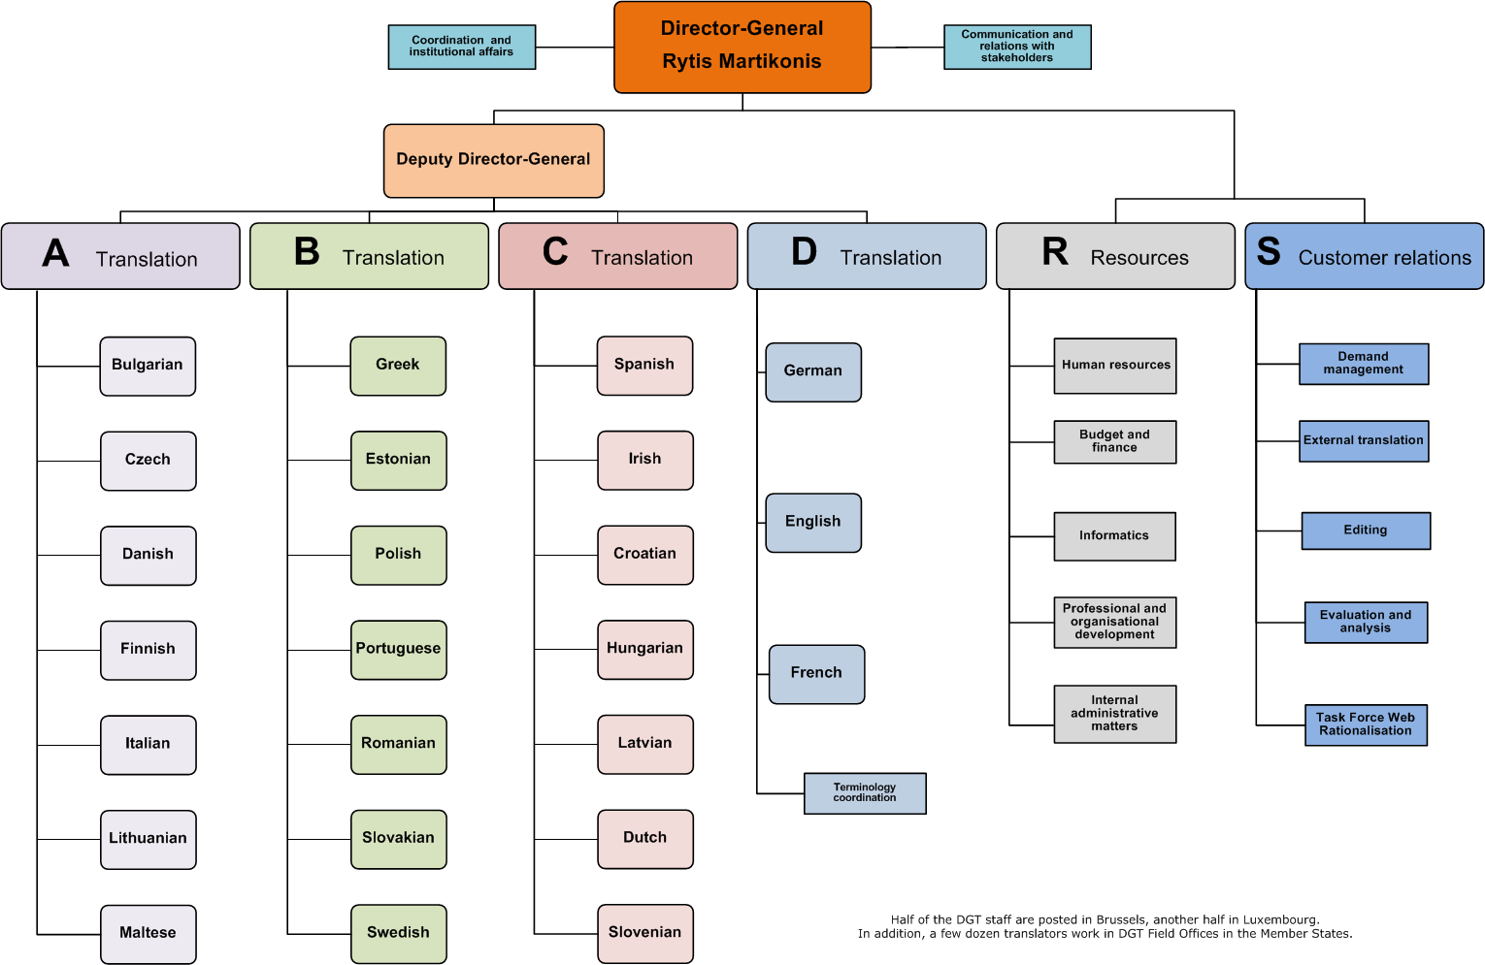
Directorate General for Translation
Notes:
After the 2004 EU enlargement, the number of pages drafted in English has been constantly increasing. It has become the principal drafting language inside the Commission because it is the second language of a large number of the Commission officials today.
Information sent to the Commission by the Member States has increased in line with every enlargement, and so has the number of pages translated into EN, FR and DE. These procedural languages are used internally – English and French the most - so that Commission officials can understand documents sent by the MS.
2015: EN 81%
FR 3.7%
DE 2.8%
Others 12.5%

Slide 4
Main document types 2015
Notes:
1: Regulations, Directives, Decisions, explanatory memoranda, impact analyses, citizen's summaries, financial statements, opinions of national parliaments and replies to them.
2: Reports required by legal acts, guides addressed to the MS, MS' legislation, recommendations, financing projects/programmes, country strategy and programming papers, documents related to infringements.
3: From/to MS, enterprises, individuals.
4: Commission's communications, reports not required by legal acts, consultation documents, White Papers.
8: Decisions of the EEA mixed committee, EFTA documents, UN/ECE Regulations, agreements between the EU and non-EU countries, negotiation guidelines.
9: Announcements, opinions, calls for tender, calls for proposals, technical specifications, contracts.
10: Meeting convocations and minutes, texts for MyIntraComm, administrative documents for staff.
11: Memorandum of law (Legal Service), documents for Administrative Commission on Social Security for Migrant Workers (CASSTM), recruitment competition texts, summaries of legislation (ScadPlus database), studies done for the Commission.

Slide 5
Evolution 2010-2015
Number of translated pages and number of DGT staff
Notes:
2 Million pages translated in 2015.
Note: The chart shows the volume of pages translated by DGT – NOT the total volume of documents drafted in the Commission. DGT doesn’t keep records of documents that never come to its workflow.

Slide 6
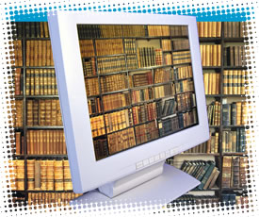
Electronic translation tools
Terminology
  IATE (public)
  EUR-Lex (public)
  Quest metasearch
  DGT Vista
  Electronic dictionaries, glossaries, Google, Wikipedia, etc.
Translation tools
  SDL Studio
  Euramis
  MT@EC
Notes:
Online information sources and tools that DGT translators use a lot in their work:
IATE (InterActive Terminology for Europe): database containing EU-related terminology used in the various European institutions.
There are two different interfaces, one for internal use and another for public access;
EUR-Lex: a compendium of all EU laws currently in force in all official EU languages;
Quest Metasearch: enables a search in several document and terminology sources at one go;
DGT Vista: search and view engine of all Commission documents produced since 1994 (original texts and translations)
Studio: the translation memory software currently in use.
Euramis is the central repository of all translated text segments.
MT@EC is the new machine translation system available for the staff of the Commission and the other EU institutions and bodies.

Slide 7
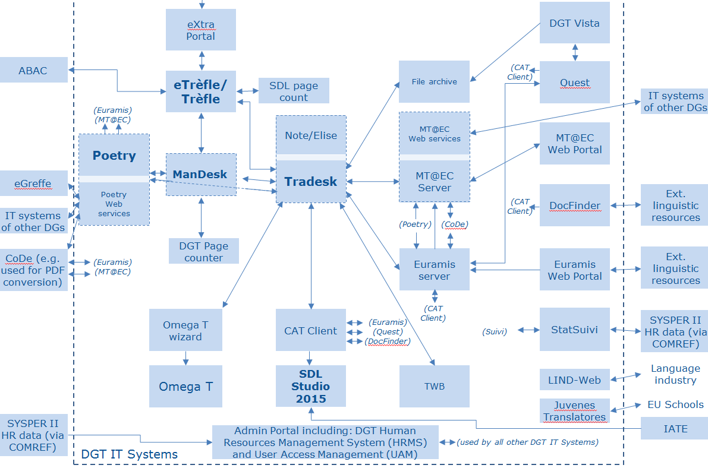

Slide 8
Context
"More (better) with less"
Stronger recourse to outsourcing
Ongoing or planned developments of corporate tools for document management and authoring
Shift from documents to content
More complexity, new formats, new ways of working

Slide 9
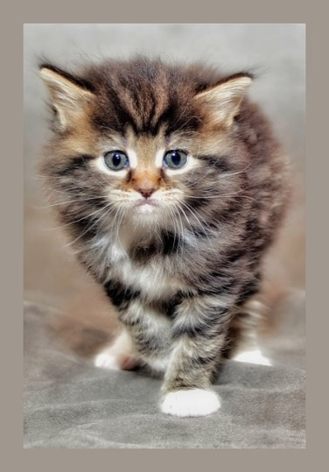
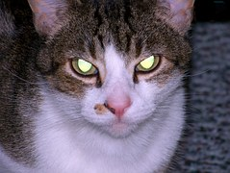

The thing about CATs….

Slide 10
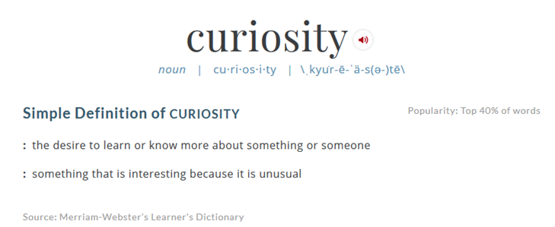

Slide 11
Not (always) a love story: translators and their tools
"If it worked I would not need incentives" - User needs of subordinate interest to developers - "…too many clicks!!!" Dissatisfaction caused by tool conception and design
"I just want to translate!" - Significant number of users are irritated by the tools - Bugs and errors

Slide 12
In the meantime….
20th century: Computer tools facilitate or replace clerical tasks (Excel, Word etc.)
21st century: Support knowledge workers
The rise of "Virtual personal assistants"?
Shouldn't all our tools be…
  User centric
  Context aware
  Always available but un-obtrusive
  Always useful
  Aware of their limitations

Slide 13

Intermission: a short rant!
Translation memories: suffering from reversed dementia?
Formats: Will standards save the day?
From lab to production?
MT: Getting better all the time…but what is the added value?
Terminology: Not all that's correct is relevant

Slide 14
CATE 2020 – an unspectacular vision
DGT CATE reflection launched in April 2014
Objectives: ensure continuity, but also prepare a sound and sustainable solution for the long term
Involve translators in the reflection process
Contribute to a vision for DGT's future CAT environment (2020)
Interinstitutional reflection started in 2016

Slide 15
From CAT to CATE
CATE: The Computer Assisted Translation Environment includes an ecosystem of language and workflow applications.
Do not focus on standalone tools, but on creating a platform that permits the integration of many information sources and tools

Slide 16
CAT Environment
Institution specific: DMS/CMS,TMS
Euramis, IATE, MT@EC, DocFinder, Quest
CAT Tool
Further development of interinstitutional tools

Slide 17
What we do know…
The future CAT environment needs to be collaborative
External Service Providers are an integral resource
The EU's legislative process is by definition interinstitutional
ATP: Translation as part of the Authoring-Translation-Publishing chain

Slide 18
CAT Environment
CAT tool
Language Resources
Automatisation and integration
Language tools
Translation memories (Central, project specific, shared)
Pre- and post-processing
Communication
Exchange of information on document or projects
Single point of access for translation,
MT engines (Generic, domain specific)
terminology databases (Central, project specific)
Corpora (Central repository, job-specific reference material)
Format handling
Batch processing…
Sharing of language data
revision,
editing,
QA (originals, translations)
alignment

Slide 19
What we don't know (yet?)
From SMT to NMT to …?
From dumb storage and reuse to learning systems?
Will semantics help us search smarter?
What will be the place of corpus linguistics?
"Big Data" – just a buzz word?

Slide 20
From CAT to CATE … but how?
No big-bang: Business continuity and sustainability are essential
Flexibility: "One-tool-fits-all" – Really?
Maturity: avoid immature or half-finished products
Continuity and sustainability are best served by a modular approach

Slide 21
…a modular approach?
Integrated and coherent working environment
More tools, less clicks?
Translator or IT expert?
Modernize, or die?
Apply the "no legacy" principle?
What will be "State of the art" in 2020?
What good are features and resources that no one uses?
Be ready for whatever comes next
What will our "business" be like?
How do you deal with uncertainty?
Deal with the legacy

Slide 22
…a modular approach!
Integrated and coherent working environment
Keep it simple
Focus on added value
Modernize the legacy systems (but don't be sentimental)
Build on sound principles, e.g.
Be ready for whatever comes next
Deal with the legacy
International standards
Interoperable solutions
Service oriented architecture
Remember: you do not build a cathedral, but a city.
"Shareable" by design

Slide 23
Tools
Principles + Technology
Processes
People
Notes:
Business as usual is not an option – the difficulty to change working methods and mind sets.

Slide 24
Dependable
Open
Graceful*
* ^{= agile, elegant …}
Notes:
Could DOGs be better CATs?

Slide 25
Thank you for your attention!

