Slide 1




Translation Quality Evaluation of MWEs from French to English using an SMT
Emmanuelle Esperança-Rodier LIG/GETALP
17-11-2016

Slide 2
MWEs?
2/24

Slide 3
MWEs – MultiWord Expressions
"multiword elements that include several graphical units, separated by blanks or hyphens, or separated by several other words not included within the MWE".
Agnès Tutin, Emmanuelle Esperança-Rodier, Manuel Iborra, Justine Reverdy, 2015, Annotation of multiword expressions in French. Malaga, Espagne, Actes de la conférence Europhras2015, Juin 2015.
3/24

Slide 4
MWEs – Examples
Even if
Death penalty
Heavy smoker
Manufacturing industry
➔ Function Word
➔ Full Phraseme
➔ Collocation
➔ Technical Term
4/24
Notes:
Out of those nine types, we decided to focus on five of them, which are the following ones:
First, Function words are characterized by a vague, and mainly functional, meaning. They include grammatical words such as conjunctions e.g. even if, or among others, prepositions e.g. in front of.
Second, Full Phrasemes include MWEs which are not compositional, e.g. couch potato, and/or are words, mainly nouns, which refer to specific referent, e.g. death penalty.
Collocations include frequent compositional expressions, e.g. heavy smoker.
Technical Terms, a subtype of full phrasemes, are mainly nominal full phrasemes typical of specialized corpora.
On top of the type, the MWE annotation also consists of the part of speech of the MWE, the part of speech of the elements of the MWE, and the overlapping of MWE is also annotated…

Slide 5
Translation Quality Evaluation of MWEs from French to English using an SMT
MWEs
Experimental data
Classification of translation errors
Evaluation tool
Quality of MWE translations
New tool?
5/24
Notes:
Now that I have introduced what I mean by MWE, I will present my work on Translation Quality Evaluation which is based on competences and task orientated
My first approach is to work on MWE which are very common but not always in proportions that are sufficient for MT to give successful translations. However, as MWE are typical of the language, if they are mistranslated, the end user would consider the whole translation as a poor one even if it is not the case.

Slide 6
Experimental data
One technical document (12,566 words)
French
MWE semi-automatically annotated
Moses-based SMT
AIM-WEST project (http://aim-west.imag.fr)
6/24
Notes:
Let start with a description of our corpus which is made of…
Once translated via Moses, we have proceeded to the evaluation using the following classification..

Slide 7
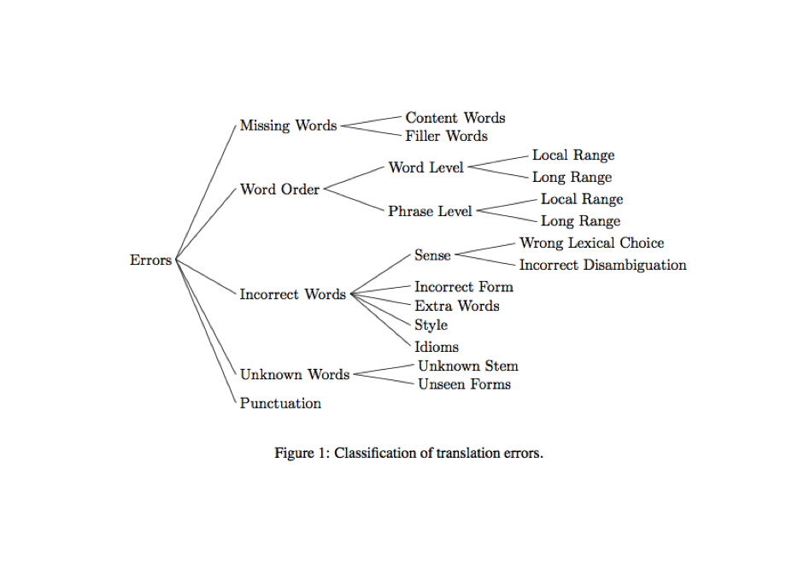
Vilar’s classification of translation errors
David Vilar, Jia Xu, Luis Fernando D’Haro et al., 2006. Error analysis of statistical machine translation output. In : Proceedings of LREC. 2006. p. 697-702.
7/24
Notes:
Linguistic classification
…
However, we wanted to track some more pieces of information. We have therefore added to the Vilar's classification the four following features.

Slide 8
Vilar’s classification of translation errors
Extended
8/24
Notes:
Consequently we have added the following things
…
Those 4 features have been added to the evaluation tool criteria I am going to present now that I am done with the classification description

Slide 9
Evaluation Tool: BLAST (Stymne 2011)
9/24
Notes:
We have used Blast
…
Now that you have an idea of how blast looks like I am going to describe the results

Slide 10
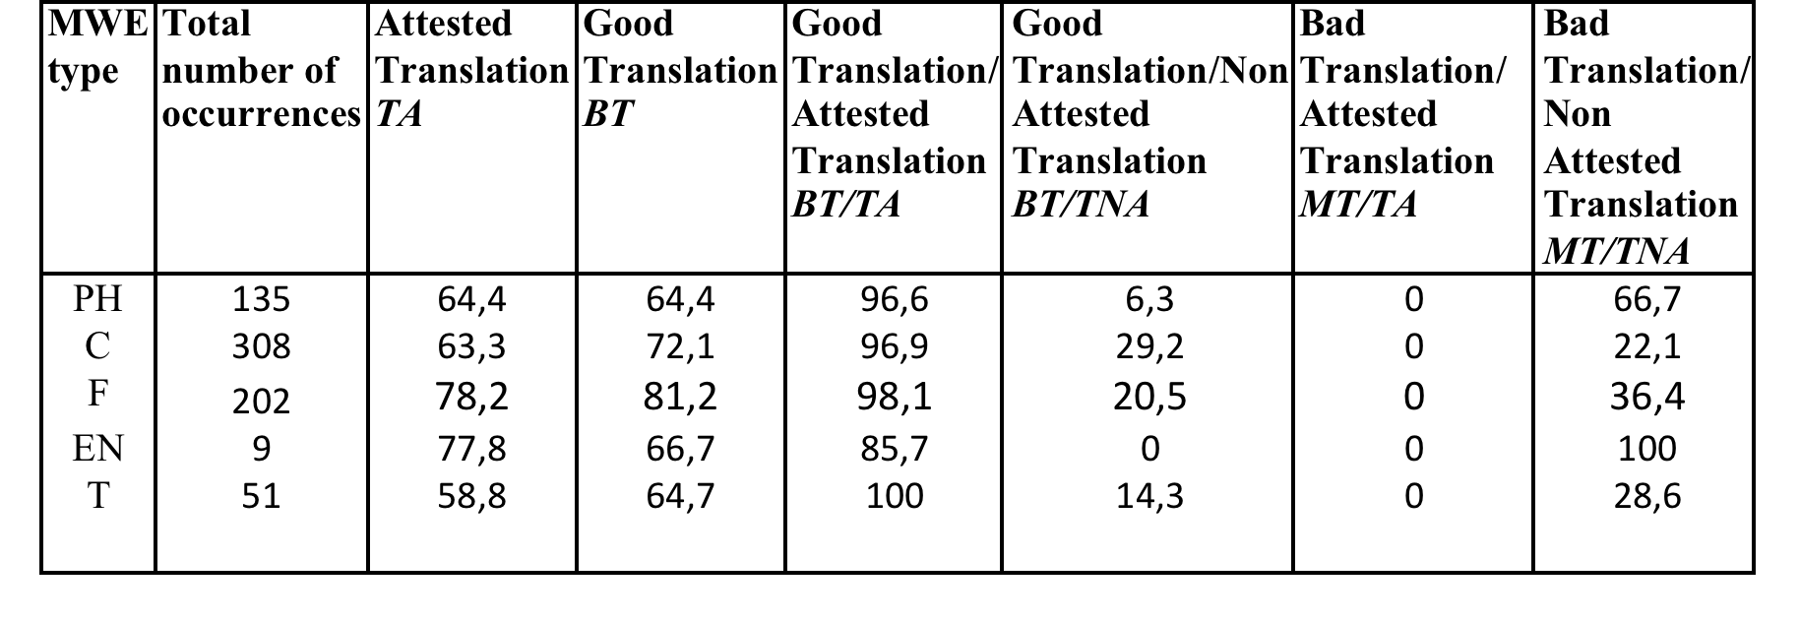
Global results for 5 MWE types on Good Translation
10/24
Notes:
the Collocation type (C), with 308 occurrences.
the smallest quantity is the Named Entities (EN), 9 occurrences
the ratio of bad translation over the not attested translation (MT/TNA), given in the eighth column, for EN is the highest with 100%. It means that when a MWE of the Named Entity type has been translated by a non attested translation it was also always a bad translation.
On the contrary, when a MWE of the Technical Term Type (T) was translated by an attested translation, it was always a good translation. The ratio good translation over attested translation, BT/TA, is 100% as mentioned in column number 5.
As a validity control, when an attested translation was given, it has never been a bad translation. The ratio MT/TA, appearing in the seventh column, is 0% for any type of MWE.

Slide 11
Attested translation
11/24
Notes:
the Collocation type (C), with 308 occurrences.
the smallest quantity is the Named Entities (EN), 9 occurrences
the ratio of bad translation over the not attested translation (MT/TNA), given in the eighth column, for EN is the highest with 100%. It means that when a MWE of the Named Entity type has been translated by a non attested translation it was also always a bad translation.
On the contrary, when a MWE of the Technical Term Type (T) was translated by an attested translation, it was always a good translation. The ratio good translation over attested translation, BT/TA, is 100% as mentioned in column number 5.
As a validity control, when an attested translation was given, it has never been a bad translation. The ratio MT/TA, appearing in the seventh column, is 0% for any type of MWE.

Slide 12
Detailed results for Full Phrasemes on Good Translation
French: […] qu'ils sont soumis à une forte pression […]
English SMT Translation:
[…] that they are under pressure […]
Error Annotation path: ph-TA-BT-MULT
12/24
Notes:
Traduction Attestée found in TRADOOIT
Bonne Traduction = traduit correctement
MULT = several words too in English

Slide 13
Global results for 5 MWE types on Good Translation
13/24
Notes:
the Collocation type (C), with 308 occurrences.
the smallest quantity is the Named Entities (EN), 9 occurrences
the ratio of bad translation over the not attested translation (MT/TNA), given in the eighth column, for EN is the highest with 100%. It means that when a MWE of the Named Entity type has been translated by a non attested translation it was also always a bad translation.
On the contrary, when a MWE of the Technical Term Type (T) was translated by an attested translation, it was always a good translation. The ratio good translation over attested translation, BT/TA, is 100% as mentioned in column number 5.
As a validity control, when an attested translation was given, it has never been a bad translation. The ratio MT/TA, appearing in the seventh column, is 0% for any type of MWE.

Slide 14
Detailed results for Full Phrasemes
on Good Translation
French: […] nous allons ensuite faire état des méthodes […]
English SMT Translation: […] then we are going to present the methods […]
Error Annotation path: ph-TNA-BT-MULT
14/24
Notes:
TNA traduction not in TRADOOIT
BT Well translated
MULT translated in several words in English too

Slide 15
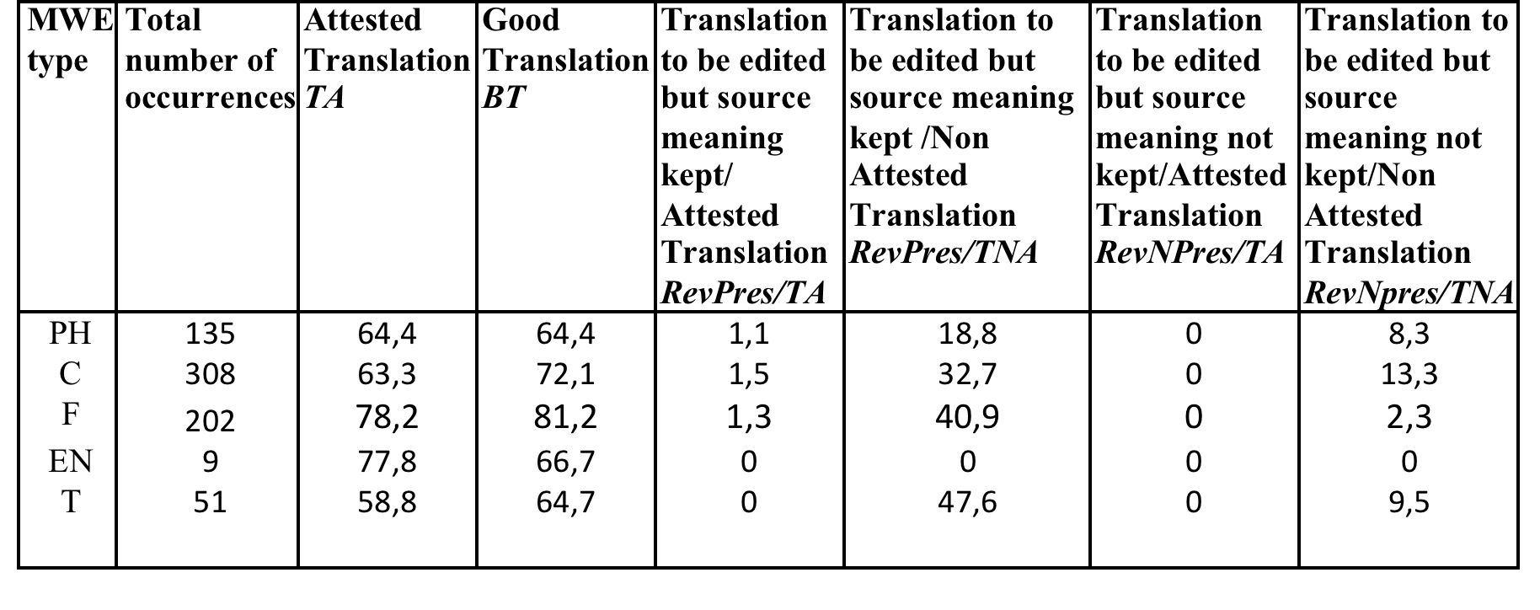
Global results for 5 MWE types on Translation to be edited
15/24
Notes:
In the same way, for validity control, we can notice on Table 2 that for an attested translation given, no translation evaluated to be edited with the meaning not being kept were found. For all the MWE types, the ratio RevNPres/TA, given in the seventh column, equals 0.
that 1% of the translations has been evaluated as needing to be edited while the meaning was kept when an attested translation existed.

Slide 16
Detailed results for Full Phrasemes on Translation to be edited
French: […] les principales adaptations requises mises en oeuvre […]
English SMT Translation: […] the major adaptations required to be implemented […]
Error Annotation path: ph-TA-REV_PRES-MULT-NONM-NONO-INC-FORME-NONU-NONPCT
16/24
Notes:
TA found on TRADOOIT
REV_PRES to be edited while meaning kept
MULT translated by several words too in English
NONM
NONO
INC-FORME wrong form passive
NONU
NONPCT

Slide 17
Global results for 5 MWE types on Translation to be edited
17/24
Notes:
In the same way, for validity control, we can notice on Table 2 that for an attested translation given, no translation evaluated to be edited with the meaning not being kept were found. For all the MWE types, the ratio RevNPres/TA, given in the seventh column, equals 0.
that 19% of the translations have been evaluated as needing to be edited while the meaning was kept when the translation was not an attested one

Slide 18
Detailed results for Full Phrasemes on Translation to be edited
French: […] ont été prises en charge par la production […]
English SMT Translation:
[…] have been taken over by the production […]
Error Annotation path: ph-TNA-REV_PRES-MULT-NONM-NONO-INC-SENS-LEX-NONU-NONPCT
18/24
Notes:
SENS LEX wrong lexical choice.

Slide 19
Global results for 5 MWE types on Translation to be edited
19/24
Notes:
In the same way, for validity control, we can notice on Table 2 that for an attested translation given, no translation evaluated to be edited with the meaning not being kept were found. For all the MWE types, the ratio RevNPres/TA, given in the seventh column, equals 0.
LAST
only 8% of the translations have to be edited when it was not an attested translation of the Full Phraseme MWE.

Slide 20
Detailed results for Full Phrasemes on Translation to be edited
French: mais en bout de ligne […]
English SMT Translation: but at the end of the line […]
Error Annotation path: ph-TNA-REV_NONPRES-MULT-NONM-NONO-INC-SENS-DESAMB-NONU-NONPCT
20/24
Notes:
evaluated as needing to be edited with the meaning not being respected because of the use of Incorrect Words due to an Incorrect Disambiguation related to the Sense subcategory.
Now that we have finished with the results it is time to conclude

Slide 21
Evaluation
80% MWEs in French were MWEs in English
21/24
Notes:
Once we have seen
MWE
Corpus
Classification
Results shown a rather good rate of translation quality but this work has conducted us to another kind of conclusion

Slide 22
A new tool?
annotating several MWEs in a same sentence
access to several error types at the same time for the same MWE.
translation consistency
collaborative tool
22/24
Notes:
Nevertheless we have experienced mainly two kinds of problems with the evaluation criteria. Firstly, we have encountered the borderline case of annotating several MWE in a same sentence. When several MWEs were present in a same sentence, it was impossible for us to link the translation error category respectively to the related MWE.
Secondly, as Blast ignores identical annotation, it seems impossible to have access to several error types at the same time for the same MWE. Also because of the hierarchical structure of the tool, we had to declare all the possible path of translation error annotation, thus having a linear path.
It would have been useful to check if the same MWE appeared several time in the document to verify the translation consistency. Is the MWE always translated in the same way, according to its place in the sentence, or to the syntactic pattern in which the MWE has been found? As Blast only allows to search for error categories, and that it does not permit to search for words or patterns, we could not proceed to such an investigation.
collaborative tool would have been greatly appreciated for the MWE quality translation evaluation.

Slide 23
Thanks for your attention!
Any Questions?
23/24
Notes:
Nevertheless we have experienced mainly two kinds of problems with the evaluation criteria. Firstly, we have encountered the borderline case of annotating several MWE in a same sentence. When several MWEs were present in a same sentence, it was impossible for us to link the translation error category respectively to the related MWE.
Secondly, as Blast ignores identical annotation, it seems impossible to have access to several error types at the same time for the same MWE. Also because of the hierarchical structure of the tool, we had to declare all the possible path of translation error annotation, thus having a linear path.
It would have been useful to check if the same MWE appeared several time in the document to verify the translation consistency. Is the MWE always translated in the same way, according to its place in the sentence, or to the syntactic pattern in which the MWE has been found? As Blast only allows to search for error categories, and that it does not permit to search for words or patterns, we could not proceed to such an investigation.
collaborative tool would have been greatly appreciated for the MWE quality translation evaluation.

Slide 24
References
Philipp Koehn, Hieu Hoang, Alexandra Birch, Chris Callison-Burch, Marcello Federico, Nicola Bertoldi,Brooke Cowan, Wade Shen, Christine Moran, Richard Zens, Chris Dyer, Ondrej Bojar, Alexandra Constantin, and Evan Herbst, 2007. Moses: Open source toolkit for statistical machine translation. In Proceedings of the 45th Annual Meeting of the Association for Computational Linguistics Companion Volume Proceedings of the Demo and Poster Sessions , pages 177–180, Prague, Czech Republic, June. Association for Computational Linguistics.
Carlos Ramisch, Aline Villavicencio, Christian Boitet, 2010. mwetoolkit: a Framework for Multiword Expression Identification Proceedings of the International Conference on Language Resources and Evaluation, LREC 2010, 17-23 May 2010, Valletta, Malta
Carlos Ramisch, Laurent Besacier, Alexander Kobzar, 2013. "How hard is it to automatically translate phrasal verbs from English to French?", MT Summit 2013 Workshop on Multi-word Units in Machine Translation and Translation Technology, Nice, France, September 2013.
Sara Stymne, 2011. Blast: A tool for error analysis of ma- chine translation output. In Proc. of the ACL 2011 System Demonstrations, pages 56–61, Portland, OR, USA, Jun. ACL.
Agnès Tutin, Emmanuelle Esperança-Rodier, Manuel Iborra, Justine Reverdy, 2015, Annotation of multiword expressions in French. Malaga, Espagne, Actes de la conférence Europhras2015, Juin 2015.
David Vilar, Jia Xu, Luis Fernando D’Haro et al., 2006. Error analysis of statistical machine translation output. In : Proceedings of LREC. 2006. p. 697-702.
24/24

