Slide 1
From CATs to KATs
Félix do carmo, luís trigo AND BELINDA MAIA
London, november 2016

Slide 2
CAT – Computer-Assisted Translation KAT – Knowledge-Assisted Translation

Slide 3
The evolution from CATs to KATs
Translators’ reality
Translation, Revision, Post-editing, Project management
Constant need for better tools
Specifications for new tools
Based on processes and procedures
References
Translation Studies research
Translation processes
Translation tools
Computer Sciences research
Machine Translation (MT) -> Statistical Machine Translation (SMT)
Natural Language Processing, Machine Learning, Artificial Intelligence, Augmented Intelligence

Slide 4
Translator’s reality

Slide 5
Processes and procedures
Three processes
Translation
Revision
Post-editing
Translation process
Cognitive approaches
Decision – outside the scope of this paper
Four translation procedures/stages
Management
Research
Writing/editing
Revising/checking

Slide 6
Translating with CATs
Translating new segments
Support of terminology and concordancers (word-level)
Overwriting source text
Editing fuzzy matches
Support by highlighting differences
Edit differences on translation suggestion
Re-edit when these are repeated in the text
Checking repeated content
Support from the TM (segment-level)
Validate or edit
Notes:
Example of re-edits: Copyright notices with different dates, lists of product names and brands

Slide 7
Revising with CATs
Read the whole translation
Source and target text
Check references
Repeat the translation process
Validate decisions
Decide differently
Support for revision
The same as for translation
Terminology, condordances
QA checks
Maintain reference material

Slide 8
Post-editing with CATs
Translating new segments
MT translation hypothesis replaces the source text
Support of terminology and concordancers (word-level)
Editing by overwriting the translation hypothesis
Editing fuzzy matches
Support by highlighting differences
Edit differences on translation suggestion
Re-edit when these are repeated in the text
Checking repeated content
Support from the TM (segment-level)
Validate or edit
There is no specific support for Post-editing or Editing:
Post-edited segments have the same CAT word-level support as in the translation process
Fuzzy matches, which have most of the editing effort, still only have the CAT tool “difference highlight” support

Slide 9
Advanced support in CATs
QA, spelling and grammar checks
Non-linguistic details
Based on word processors
Predictive writing
Auto text suggestions, based on terminology or bilingual databases
Web search simplified
Embedded web favourite lists
Fuzzy match composition
Create translation suggestions from fragments
Project management
Package together texts, TMs and Termbases
Control productivity, quality, etc.
Beyond CATs: Web and MT tools
Interactive Machine Translation

Slide 10
Recommended specifications for new tools

Slide 11
4 procedures/stages
1) Management
Connect texts to resources
2) Research
Learn from searches
3) Writing/editing
Translation - overwriting
Editing - 4 editing actions
4) Revising/checking
Focus on specific tasks

Slide 12
1) Management
Leverage the linguistic knowledge existing in texts, TMs and other resources
Use “Technical domain” as the central feature to allocate the right contents to the right projects and to the right people
Tasks and stages:
For each new project, use classification techniques to identify the technical domain
Use clustering techniques to associate the appropriate bilingual data (TMs, MT engines, references) to the project based on technical domain
Associate people to domains based on the analysis of texts they produced
Classify people according to specialisations, based on networks of texts
Assign people to projects based on specialisations
Management system by visual representations of proximity scales, or connections based on similarity

Slide 13
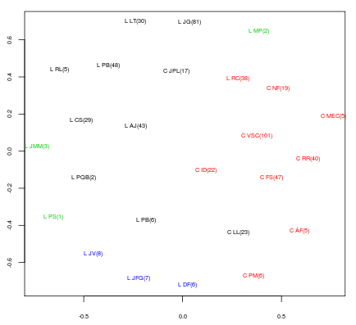
MDS representation
Figure 1: MDS representation of colour-coded clusters of documents/resources
Notes:
The first approach is the Multidimensional Scaling (MDS) representation, which transforms the n-term dimensions that characterize documents/resources in a 2D representation, providing a spatial proximity insight for each. In this picture, researchers were clustered based on the proximity of their abstracts.
(Trigo)

Slide 14
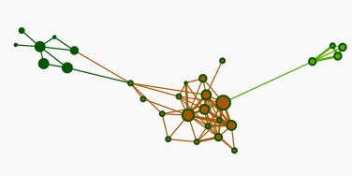
Graph-based approach
Figure 2: Network of people in a R&D unit/center
Notes:
The second option is the graph-based approach, which represents similarities between “documents” as links.
This concept is developed in the Affinity Miner project (Trigo et al., 2015), where it is applied to grasp affinity groups in and between publications of research centres. Document similarity is generated by a simple Bag of Words and vector representation (Feldman and Sanger, 2007).
The importance of each document is highlighted visually by the size of the node corresponding to the number of publications and centrality within the graph. The centrality measure identifies the strongest element in each node, which could be, in our translation management environment, the translator with the highest rank in terms of number of words translated in a technical domain.

Slide 15
2) Translator’s research
TMs and references (unaligned corpora) clustered by domain
Specialised search engines
Vertical web search engines
Log and cluster web sites used as references
Crawl the web for similar references
Terminology and keyword extraction
Extract word and multi-word units
Create ontologies
Visualise clusters of words
Named Entity Recognition
Identify names of people, institutions and places, dates and other non-translatable elements
Mark them for exclusion from the MT system

Slide 16
Research – knowledge base
Build a local knowledge-base with these details
Web references
Named Entities
Terminology and ontologies
Ownership issues
Owned by the translator – empower and support translator’s specialisation
Shared with the reviser or production team – useful to validate confidence in translator
The more specialised the references, the more confidence in the translator

Slide 17
3) Writing/editing
Translation
Overwriting
Predictive writing (typeahead)
Post-editing based on four editing micro-tasks or actions
Deleting
Inserting
Moving
Replacing
Support specifically these four actions
Machine Learning used in Quality Estimation
Present suggestions for the editing actions

Slide 18
Interactive DELETION
Learn “deletion” and suggest the same action in similar contexts
SOURCE | MT SUGGESTION | POST-EDITED
Acquire - to obtain possession of something | Adquirir - para obter a posse de algo | Adquirir - obter a posse de algo
Align - to place something in an orderly position in relation to something else | Alinhar - para colocar algo em uma posição ordenada em relação a outra coisa | Alinhar - colocar algo em uma posição ordenada em relação a outra coisa
Allocate - to divide something between different people or projects | Alocar - para dividir algo entre diferentes pessoas ou projetos | Alocar - dividir algo entre diferentes pessoas ou projetos

Slide 19
Interactive INSERTION
Learn “insertion” and suggest the same action in similar contexts
SOURCE | MT SUGGESTION | POST-EDITED
User Name/ID | Nome de utilizador | Nome/ID de utilizador
Patient Name/ID | Nome do paciente | Nome/ID do paciente
Item Name/ID | Nome do item | Nome/ID do item

Slide 20
Interactive MOVEMENT
Learn “movement” and suggest the same action in similar contexts
Multi-word units validated when translators “move” them
Added to translation model with a higher (101%) confidence score
SOURCE | MT SUGGESTION | POST-EDITED
VEC 1 controller pin 7 (BK) wire | Controlador VEC 1 fio do pino 7 (BK) | Fio do pino 7 (BK) do Controlador VEC 1
VEC 1 controller + (RD) wire | 1 Controlador VEC + (RD) | Fio + (RD) do Controlador VEC 1
VEC 1 controller – (BL) wire | VEC 1 controlador - (BL) | Fio - (BL) do Controlador VEC 1

Slide 21
Interactive REPLACEMENT
Learn “replacement” and suggest the same action in similar contexts
Multi-word units validated when translators “replace” them
Added to translation model as high-score alternatives to units replaced
SOURCE | MT SUGGESTION | POST-EDITED
Users must be set up and maintained at the console. | Os utilizadores têm de estar configurado e mantido na consola. | Os utilizadores têm de estar configurados e mantidos na consola.
Assess - to examine something in order to judge or evaluate it | Avaliar - examinar algo para juiz ou avaliar | Avaliar - examinar algo para ajuizar ou avaliar
Act - to do something to change a situation | Ato - fazer algo para mudar uma situação | Atuar - fazer algo para mudar uma situação

Slide 22
4) Revising and checking
Study the specificities of this stage
Eliminate the need for the reviser to repeat translator’s research, decisions and edit efforts
Setup QA checks
Manage reference material

Slide 23
Support to revision/checking
Validate the references used by the translators -> quicker confidence assessment
Highlight edits made to fuzzy matches -> quicker edit validation
Present suggestions to the 4 editing actions -> quicker editing
Build sub-segment glossaries -> quicker consistency checking
Improve QAs
Build QAs according to client instructions and Style Guides
QAs that learn from false positives
E.g. Intentional diverging translations due to different contexts
Clean and maintain TMs
Excluding misaligned translations (due to segmentation issues)
Excluding low-repeatable translations (very context-dependent)

Slide 24
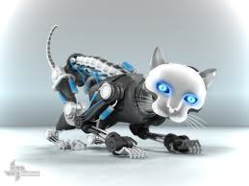
How did we get here?

Slide 25
New and intelligent tools
Build better Interactive Translation tools
Instead of trying to emulate human actions, apply the best technologies to support translation, revision and editing
Understand processes and procedures
Support specific actions performed by translators
Manage knowledge
Take advantage of all the knowledge that may be extracted from data collected in operations and actions performed by translators
KATs = Knowledge-Assisted Translation tools

Slide 26
Thank you.

