Slide 1
Professional translation in a pre-singularity world
No worries for translators in the high-grade market

Slide 2
Alan K. Melby
President of LTAC global, associate director of BYU translation research group, certified French-to-English translator

Slide 3
My position: no! not all translators will be replaced before the singularity

Slide 4
why?
Because translation is AI-complete

Slide 5
1st reason for claiming translation is ai-complete
Some language is general
(rather than domain-specific) and
dynamic
(rather than frozen)
Current MT systems can’t even handle
ambiguity and cohesion not resolved by
sentence-level co-text and
domain identification

Slide 6
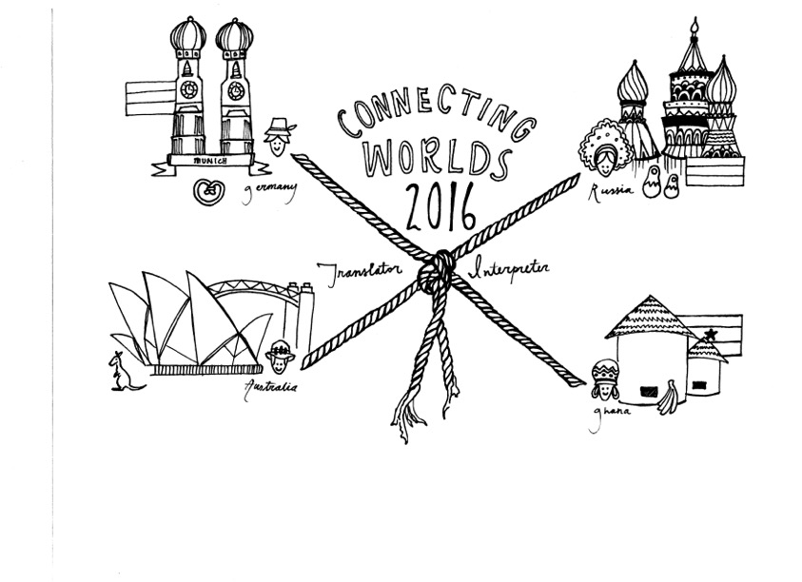
2nd reason for claiming translation is ai-complete
Some covert translation involves
adjusting culture-laden content
across contrasting locales

Slide 7
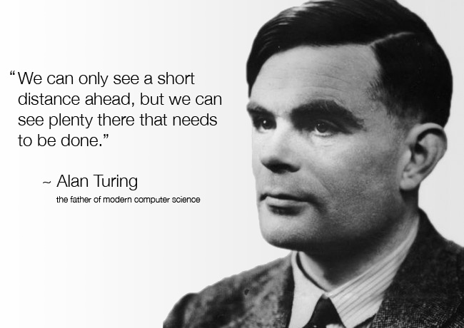
3rd reason for claiming translation is ai-complete
An MT system would at least have to pass the Translation Turing Test and be able to justify its choices relative to the project specifications

